Slide 1
2016 FEVS Results Employee Engagement Action Planning
Presentation to the Business and Operations Advisory Committee
November 30, 2016
Dr. Joanne Tornow
Notes:
Overview of 2016 FEVS Results
FEVS Index Results
2016 NSF Agency Specific Item Results
FEVS Benchmarking Results
Comparison of Supplemental FEVS Results
Employee Engagement and Action Planning

Slide 2
2016 FEVS Results Overview
Accolades
NSF recognized for improvement in Employee Engagement and New IQ in OPM’s government-wide FEVS report 3 point increase in NSF’s Employee engagement score from 2015 to 73% 3 point increase in NSF’s New IQ index of diversity and inclusion from 2015 to 65%
Benchmarking
NSF is third highest among medium and small agencies on Employee Engagement scores (behind OMB’s 78% and NRC’s 74%)
Notes:
Highlights:
Among CHCO agencies - NSF is the third highest scoring agency in the medium and small agency category behind OMB (78%) and NRC (74%)
In the government-wide management report, NSF is recognized on pg. 12 for our increased score on the Employee Engagement index and again on pgs. 30-31 for increased scores on the NEW IQ index. NSF is making solid, year-over-year increases in FEVS scores.

Slide 3
2016 FEVS Results Overview
74% response rate (government-wide 46%)
All item scores at or above government average except two
My workload is reasonable (NSF = 50%, G-wide = 57%)
Prepared for potential security threats (NSF = 75%, G-wide = 77%)
Most directorate/office index scores at or above OPM’s “strength threshold” of 65%
On-going focus areas: workload, career development, performance management
Notes:
Directorates and offices have the data and tools they need to prepare for action planning
Executive summary that provides trend results to division level
Excel workbook with division-level detailed trend results down to the item level for use in custom analysis
User Guide for analyzing FEVS results as an input into action planning
HRM is ready to assist you with action planning

Slide 4
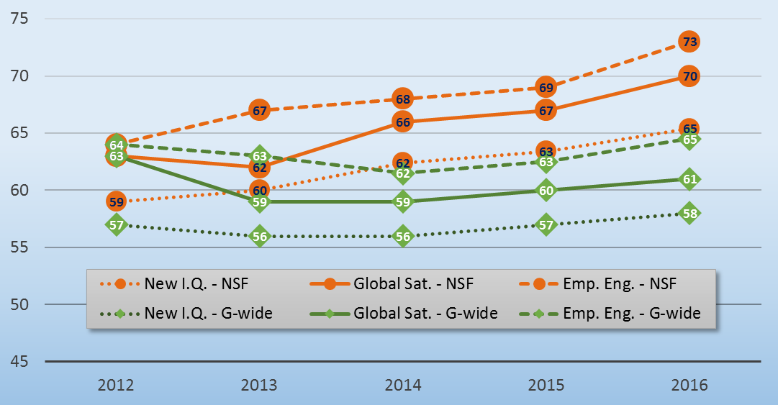
OPM’s FEVS Index Scores by Year
Notes:
Index 2012 2013 2014 2015 2016
New I.Q. - NSF 59 60 62 63 65
Global Sat. - NSF 63 62 66 67 70
Emp. Eng. - NSF 64 67 68 69 73
New I.Q. - G-wide 57 56 56 57 58
Global Sat. - G-wide 63 59 59 60 61
Emp. Eng. - G-wide 64 63 62 63 65
OPM’s New Inclusion Quotient (IQ) Index is comprised of 20 items across 5 habits:
Fair
(23) In my work unit, steps are taken to deal with a poor performer who cannot or will not improve.
(24) In my work unit, differences in performance are recognized in a meaningful way.
(25) Awards in my work unit depend on how well employees perform their jobs.
(37) Arbitrary action, personal favoritism and coercion for partisan political purposes are not tolerated.
(38) Prohibited Personnel Practices (for example, illegally discriminating for or against any employee/applicant, obstructing a person's right to compete for employment, knowingly violating veterans' preference requirements) are not tolerated.
Open
(32) Creativity and innovation are rewarded.
(34) Policies and programs promote diversity in the workplace (for example, recruiting minorities and women, training in awareness of diversity issues, mentoring).
(45) My supervisors/team leader is committed to a workforce representative of all segments of society.
(55) Managers/supervisors/team leaders work well with employees of different backgrounds.
Cooperative
(58) Managers promote communication among different work units (for example, about projects, goals, needed resources).
(59) Managers support collaboration across work units to accomplish work objectives.
Supportive
(42) My supervisor supports my need to balance work and family issues.
(46) My supervisor/team leader provides me with constructive suggestions to improve my job performance.
(48) My supervisor/team leader listens to what I have to say.
(49) My supervisor/team leader treats me with respect.
(50) In the last six months, my supervisor/team leader has talked with me about my performance.
Empowered
(2) I have enough information to do my job well.
(3) I feel encouraged to come up with new and better ways of doing things.
(11) My talents are used well in the workplace.
(30) Employees have a feeling of personal empowerment with respect to work processes.
OPM’s Global Satisfaction Index is comprised of 4 items:
(40) I recommend my organization as a good place to work.
(69) Considering everything, how satisfied are you with your job?
(70) Considering everything, how satisfied are you with your pay?
(71) Considering everything, how satisfied are you with your organization?
OPM’s Employee Engagement Index is comprised of 15 items across 3 categories:
Leaders Lead
(53) In my organization, leaders generate high levels of motivation and commitment in the workforce.
(54) My organization’s leaders maintain high standards of honesty and integrity.
(56) Managers communicate the goals and priorities of the organization.
(60) Overall, how good a job do you feel is being done by the manager directly above your immediate supervisor/team leader?
(61) I have a high level of respect for my organization’s senior leaders.
Supervisors
(47) Supervisors/team leaders in my work unit support employee development.
(48) My supervisor/team leader listens to what I have to say.
(49) My supervisor/team leader treats me with respect.
(51) I have trust and confidence in my supervisor.
(52) Overall, how good a job do you feel is being done by your immediate supervisor/team leader?
Intrinsic Work Experiences
(3) I feel encouraged to come up with new and better ways of doing things.
(4) My work gives me a feeling of personal accomplishment.
(6) I know what is expected of me on the job.
(11) My talents are used well in the workplace.
(12) I know how my work relates to the agency’s goals and priorities.

Slide 5
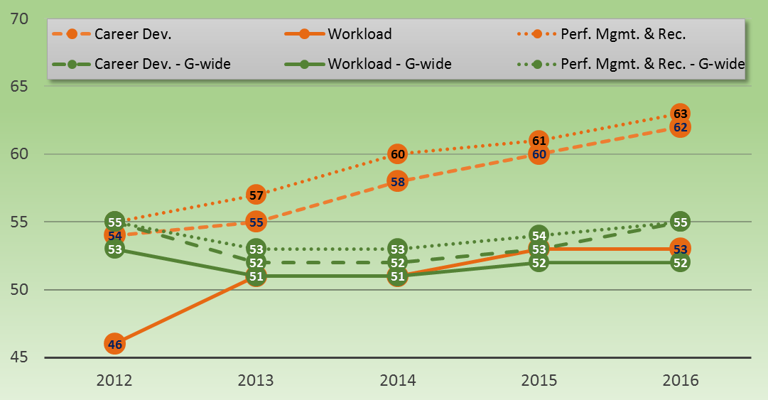
NSF’s FEVS Index Scores by Year
Notes:
Index 2012 2013 2014 2015 2016
Career Dev . . . . . . . . . . . . . . . . 54 55 58 60 62
Workload . . . . . . . . . . . . . . . . . 46 51 51 53 53
Perf. Mgmt. & Rec. . . . . . . . . . 55 57 60 61 63
Career Dev. - G-wide . . . . . . . 55 52 52 53 55
Workload - G-wide . . . . . . . . .53 51 51 52 52
Perf. Mgmt. & Rec. - G-wide 55 53 53 54 55
NSF’s Career Development Index is comprised of 10 items:
(1) I am given a real opportunity to improve my skills in my organization.
(11) My talents are used well in the workplace.
(18) My training needs are assessed.
(22) Promotions in my work unit are based on merit.
(27) The skill level in my work unit has improved in the past year.
(43) My supervisor/team leader provides me with opportunities to demonstrate my leadership skills.
(46) My supervisor/team leader provides me with constructive suggestions to improve my job performance.
(47) Supervisors/team leaders in my work unit support employee development.
(67) How satisfied are you with your opportunity to get a better job in your organization?
(68) How satisfied are you with the training you receive for your present job?
NSF’s Workload Index is comprised of 2 items:
(9) I have sufficient resources (for example, people, materials, budget) to get my job done.
(10) My workload is reasonable.
NSF’s Performance Management and Recognition Index is comprised of 14 items across 2 subcomponents:
Performance:
(6) I know what is expected of me on the job.
(15) My performance appraisal is a fair reflection of my performance.
(16) I am held accountable for achieving results.
(19) In my most recent performance appraisal, I understood what I had to do to be rated at different performance levels (for example, Fully Successful, Outstanding).
(22) Promotions in my work unit are based on merit.
(23) In my work unit, steps are taken to deal with a poor performer who cannot or will not improve.
(24) In my work unit, differences in performance are recognized in a meaningful way.
(33) Pay raises depend on how well employees perform their jobs.
(44) Discussions with my supervisor/team leader about my performance are worthwhile.
(46) My supervisor/team leader provides me with constructive suggestions to improve my job performance.
(50) In the last six months, my supervisor/team leader has talked with me about my performance.
Awards & Recognition:
(25) Awards in my work unit depend on how well employees perform their jobs.
(31) Employees are recognized for providing high quality products and services.
(32) Creativity and innovation are rewarded.

Slide 6
2016 FEVS Item-Level Results Overview
Greatest Increase 2012-2016 | (64) How satisfied are you with the information you receive from management on what's going on in your organization? | 14.6
Greatest Decrease 2012-2016 | N/A - No questions had a net decrease over 2012-2016 | N/A
Greatest Increase 2015-2016 | (54) My organization's leaders maintain high standards of honesty and integrity. | 7.3
Greatest Decrease 2015-2016 | (14) Physical conditions (for example, noise level, temperature, lighting, cleanliness in the workplace) allow employees to perform their jobs well. | -3.8
Top Five Largest Increases 2012 to 2016 | NSF 2012 | NSF 2016 | ∆ 2012-2016
(64) How satisfied are you with the information you receive from management on what's going on in your organization? | 46.2% | 60.8% | 14.6
(44) Discussions with my supervisor/team leader about my performance are worthwhile. | 59.1% | 72.7% | 13.6
(19) In my most recent performance appraisal, I understood what I had to do to be rated at different performance levels (for example, Fully Successful, Outstanding). | 62.4% | 75.2% | 12.8
(66) How satisfied are you with the policies and practices of your senior leaders? | 40.1% | 52.4% | 12.3
(15) My performance appraisal is a fair reflection of my performance. | 67.2% | 79.5% | 12.3
Notes:
Items with lowest scores:
(32) Creativity and innovation are rewarded. 52.8%
(66) How satisfied are you with the policies and practices of your senior leaders? 52.4%
(10) My workload is reasonable. 50.2%
(53) In my organization, leaders generate high levels of motivation and commitment in the workforce. 49.2%
(25) Awards in my work unit depend on how well employees perform their jobs. 46.2%
(22) Promotions in my work unit are based on merit. 46.0%
(24) In my work unit, differences in performance are recognized in a meaningful way. 39.5%
(67) How satisfied are you with your opportunity to get a better job in your organization? 38.9%
(23) In my work unit, steps are taken to deal with a poor performer who cannot or will not improve. 34.4%
(33) Pay raises depend on how well employees perform their jobs. 34.3%

Slide 7
2016 NSF-Specific Item Results
Relocation (communications and intent to leave)
Inclusive environment
Resolving disagreements
Notes:
Thoughts on questions for the 2017 FEVS?
Questions and % strongly agree/agree:
Q1. Overall I am satisfied with the information and communications I receive about NSF’s move to the new location. 73.9%
Q2. I am likely to leave in the next two years due to NSF moving to its new location. 14.9%
Q2.1. I am likely to leave in the next two years, but not due to the move. 13.4%
Q3. How satisfied are you that your Directorate/Office provides an inclusive work environment? 78.5%
Q4. How satisfied are you that the NSF provides an inclusive work environment? 75.3%
Q5. Disagreements are resolved fairly in my Directorate/Office. 51.4%
Q6. I am comfortable raising alternative views within my division team. 67.4%
Q7. My supervisor is good at dealing with disagreements within our area (e.g., division, branch, team) 57.6%
Q8. My supervisor holds all employees equally accountable for achieving results. 59.1%

Slide 8
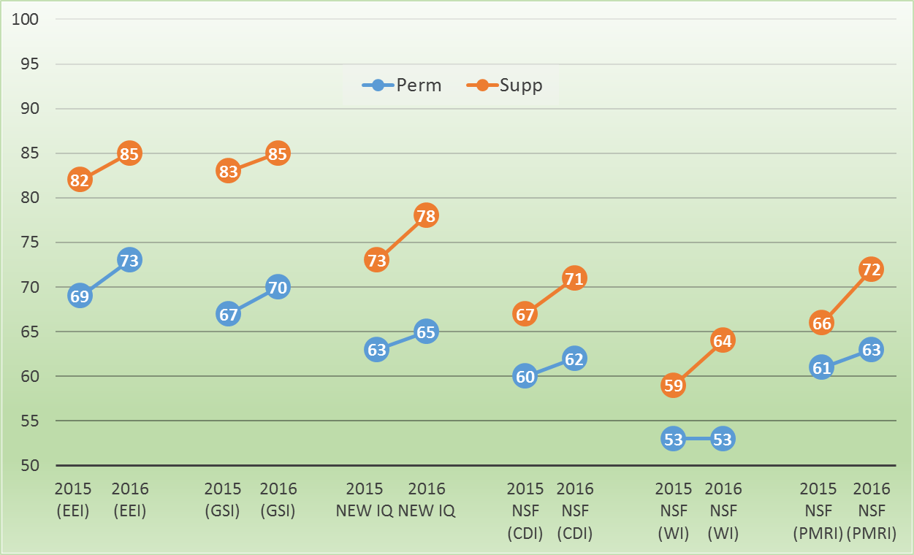
Comparison of Index Scores Across Perm & Supplemental FEVS Results for 2015 and 2016
Notes:
Key Points:
Year-over-year - Temporary staff provide more positive scores than permanent staff
For the supplemental Survey Results
Five of the Six index scores increased by 3 or more points from 2015
62 of the 71 FEVS questions have scores that are above 65% positive – strengths

Slide 9
Agency Benchmark Results – 2016
Notes:
Purpose: To compare Federal Employee Viewpoint Survey (FEVS) results between NSF and selected comparable agencies. These agencies were selected for their similarity in size and/or mission to NSF.
Benchmark Agencies: The agencies selected for benchmarking were:
Nuclear Regulatory Commission (NRC)
U.S. Agency for International Development (USAID)
Office of Personnel Management (OPM)
Department of Education (ED)
National Aeronautics and Space Administration (NASA).
Benchmark Group Score is the average of the five agencies listed above.
Note: In previous benchmarking analyses, NASA Headquarters was included as one of the benchmark agencies. Since OPM does not release the full FEVS data set until late December, results for the entire agency are included in this analysis.
Key Points:
NSF scored higher than the government-wide average on every index.
NSF scored lower than the benchmark average on two (i.e., OPM New IQ, NSF Workload Index) of the six indices.
NSF received the highest index score on the OPM Employee Engagement Index.
NSF received the lowest index score on the NSF Workload Index.

Slide 10
Employee Engagement Model
ENGAGEMENT
OUTCOMES Individual
Team
Organizational
Positive work environment
Pride in one’s work or workplace
Job Satisfaction
Innovation
Discretionary Effort
Performance
Productivity
Retention
Enhanced Customer Service
Prospect for future personal or professional growth
Satisfaction with leadership
Satisfaction with recognition received
Opportunity to perform well at work
Adapted from: OPM, Engaging the Federal Workforce: How to Do It and Prove It, and MSBP Report, The Power of Federal Employee Engagement
Notes:
There are many models of employee engagement but most contain similar elements. We use this one to communicate the elements of the working environment that result in engagement:
* PRIDE IN ONE’S WORK OR WORKPLACE: In order to be engagement people need to feel emotionally connected to the work they do and the mission of the organization.
* SATISFACTION WITH LEADERSHIP: This includes supervisors and above. The relationship between supervisors and direct reports is the strongest predictor of engagement since they have most impact on everyday lives of people. The relationship needs to be based on trust, autonomy, and fairness. At higher levels, leaders need to provide vision and steer the agency toward that vision.
* OPPORTUNITY TO PERFORM WELL AT WORK: is important contributor to employee engagement in the Federal Government. This means knowing what is expected on the job, being able to use one’s skills and also having challenging assignments, and having resources.
* SATISFACTION WITH RECOGNITION RECEIVED: Recognition is central to engagement. It may be monetary or nonmonetary awards, or a simple acknowledgement of a job well done.
Productive
* PROSPECT FOR FUTURE PERSONAL AND PROFESSIONAL GROWTH: the ability to progress in one’s career at a organization is an important part of engagement. However, this is not always possible in smaller and flatter organizations. It is important to emphasize that growth can mean learning new skillsets, rotating to other assignments, lead projects, or exercise leadership roles on teams.
POSITIVE WORK ENVIRONMENT – last but not least, a respective, collaborative, trusting work environment is an important precursor to engagement.
All together, these factors make it more likely that a person will be engaged, which will result in positive outcomes for an individual, team, and the organization as a whole.

Slide 11
FY17 Directorate Engagement Action Planning Timeline
Start FY17 Employee Engagement Cycle
Customized Support (options range from hands-on advising to self-directed guidance/tools)
October
November
January-March
April-Sept
October-December
Conduct Preparing for Action Planning Briefing (AMG/DLG)
▪ Share guidance
▪ Schedule Action Planning advising meetings
▪ Identify desired level of action planning support
▪ Assess progress, diagnose challenges, and develop FY17-19 Action Plans
▪ Conduct advising meetings
Promising practices series
Conduct check-in meetings based on 2017 FEVS
Action plans due 3/31/17
Notes:
Types of customized support that can be provided by HRM:
Access to hands-on consulting and advice from SHCP
Access to internal and external facilitation services
Schedule a meeting to provide overview of process and resources
Self-directed use of action planning tools and guidance
Attend Promising Practices Brownbag Series
Participate in bi-annual progress check-ins with SHCP

Slide 12
Feedback from the Committee
How does NSF continue to maintain its progress in the coming year?
How do we avoid complacency?
How do supervisors and managers best engage with employees on the results?

